Slide 1
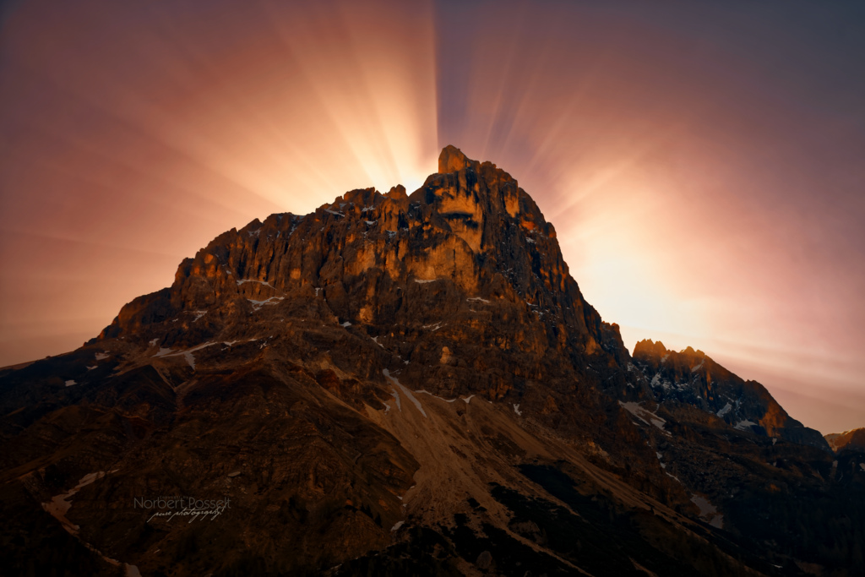
Grace…
A Beautiful and Divine Exchange
23 Oct 2016
Notes:
GRACE: A Beautiful and Divine Exchange
Exo 24: 12 – Come up and meet me there.
Introduction
In the past few weeks, there have been quite significant themes. We listened to a message on being crucified with Christ – it’s no longer I who lives but Christ who now lives inside of me. And because I am thoroughly dead to myself -to my passions, my old self, to the world, the life of Christ radiates through me. That's like what we learned in Life Group this week covering the scriptures on the four point prayer – we present ourselves to God first. When we lift up our hands a living sacrifice (as the morning and the evening sacrifice), it is an act of surrender. Only when we do this can we experience the next part which is spirit of wisdom and revelation and the eyes of understanding being opened. Christ is then formed in us as we repeatedly apply this pattern. We heard a message on how true Sons of God are led by the Spirit and when we tune our frequency to the frequency of God, we can be effective. Last week we heard a message on encountering God. What excuses do we have? Jesus has offered us to drink from the fountain of living water.
So this morning, I would like to invite you to come and encounter God with me. Exo 24:12 God said to Moses Come up to Me on the mountain and be there.
There are a lot of places that we might rather be – the beach, in bed, having breakfast somewhere. But God wants us to come up to Him and to be there. What does this mean? It means to not just be physically here but mentally, emotionally and spiritually here. Are you here?
This morning, I would like to share on GRACE, a Beautiful and Divine exchange that happens when we come up to the mountain of God and transact with Him.

Slide 2
2 Cor 12:9
"And He said to me, “My grace is sufficient for you, for My strength is made perfect in weakness. Therefore most gladly I will rather boast in my infirmities, that the power of Christ may rest upon me. Therefore I take pleasure in infirmities, in reproaches, in needs, in persecutions, in distresses, for Christ’s sake. For when I am weak, then I am strong."
Notes:
We like to appear like we have everything together. I do. I hate looking and feeling dumb. I hate having to rely on other people when I can do things myself.
And sometimes, we do that to God. God – I'll come to You and serve You when I have everything together. When my life is sorted and I've finished uni. Or when I've just finished this thing, this project, or when the kids have grown up. And we make excuses.
Last week, we heard a moving preaching by Uncle Ming on encountering God. What are our excuses for serving Him? The woman at the well gave lots of excuses – she covered it behind seemingly spiritual things. We worship at this mountain. But Jesus saw right through the excuses. He looked right into her heart. And despite her flaws, her weakness, her obvious issues (she had five husbands and the sixth man she was with she wasn't married to!!!), He invited her to drink from the fountain of living water. He offered her an exchange.
My strength is made perfect in your weakness.
See none of us like that. Can we really trust God? No back up plans? No "safety net". No insurance. What’s our excuse this morning? Jesus wants to take us just as we are and use as where we are. He's not expecting perfection first up. But He does expect surrender.

Slide 3
Grace: A Beautiful and Divine Exchange
Definitions:
Unmerited favour
The desire and the power to do God's will
Great Riches at Christ's expense.
It's all of the above!
John 1:16 (AMP)
For out of His fullness [the superabundance of His grace and truth] we have all received
Grace upon Grace
[spiritual blessing upon spiritual blessing, favor upon favor, and gift heaped upon gift].
Notes:
These are definitions of Grace that we have all heard before. I would like to propose these definitions collectively sum up Grace. It is unmerited favour: great riches at Christ’s expense. But once we have received this grace unto salvation, it becomes the desire and the power to do God’s will.
In John 1, it says that we have all received grace upon grace. Not just some grace. But grace upon grace upon grace upon grace. Heaped upon us. God’s favour heaped upon us. His desire and His power to do His will. What an amazing statement. Out of his superabundance. Out of the fullness of God. Out of His sufficiency, we have all that we need to meet our insufficiency. We have all that need to overcome our daily struggles and challenges and issues.

Slide 4
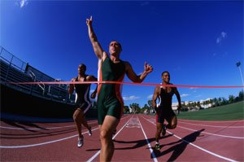
So why Grace?
Grace is for salvation
Grace is for the assignment
Grace is for reigning
Notes:
We are going to see in scripture that grace is given to us for three things: for salvation (our salvation experience is a work of God’s grace) but it doesn’t stop there. As we progress in our Christian life, God’s grace is dispensed for us to complete our assignment and it is released on us for reigning with Him through righteousness.
Let’s read the scriptures that tell us about these three things about why Grace is given.

Slide 5
Notes:
Conclusion:
This morning, God wants us to transact with Him on the mountain. We trade our weakness for His Grace. His strength is made perfect when we are weakest. It requires surrender. It requires truth in the inwards parts. It requires sacrifice. It requires us to lay aside pride. And come to Him.
It's no longer I that live, But Christ that lives inside of Me. His strength is made perfect in our weakness.

